Slide 1
UserLibri: A Dataset for ASR Personalization Using Only Text
ANALYZED AND PRESENTING BY
MAHFUZ SOBHAN
20101270
BASHIR SIDDIQUE
20101269

Slide 2
TABLE OF CONTENTS
01
04
02
05
03
06
Introduction
Dataset
Contributions
Experiments
Background
Conclusions

Slide 3
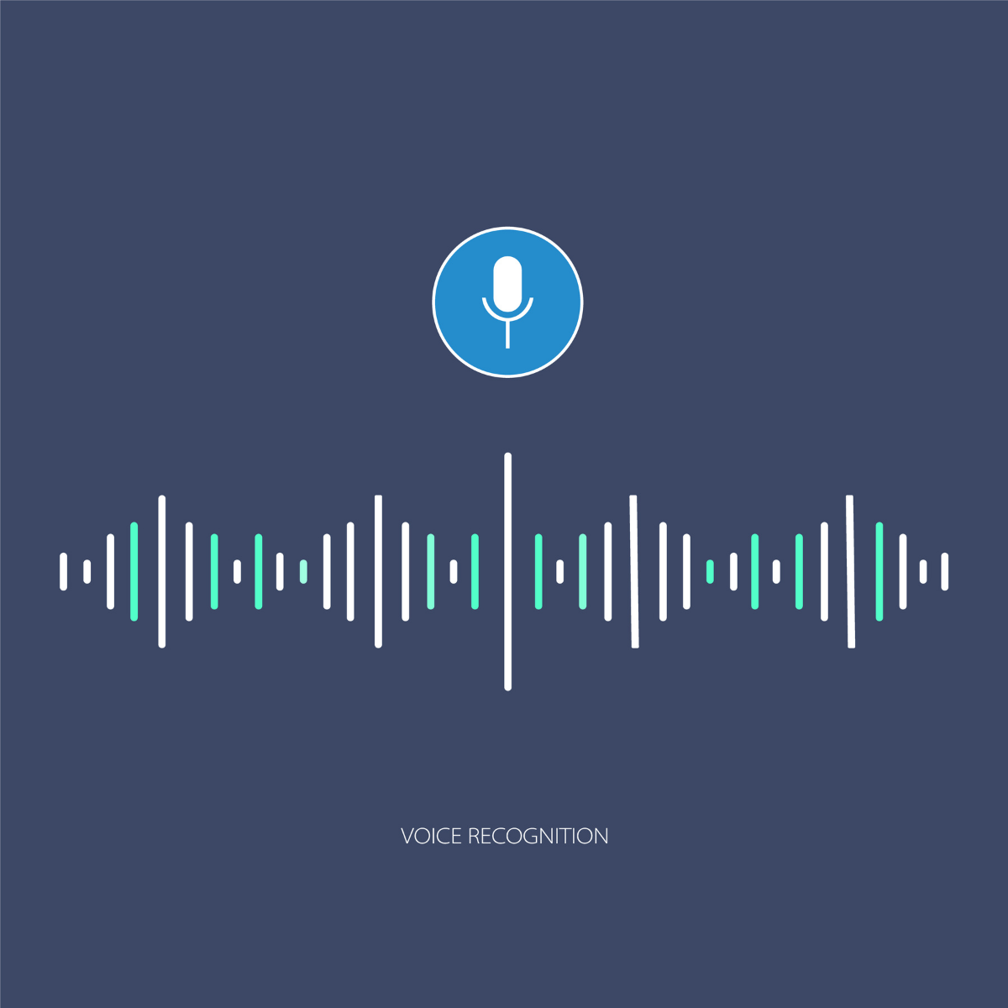
ABOUT THE PAPER
In the following paper, a group of researchers from Google analyzed speech of 55 test-clean users and 52 test-other users to improve on-device speech model for that specific user from that user’s text-only data.

Slide 4
Introduction of the Paper
They used Personalized Language Model to reduce the on-device error of user’s giver poorly processed audio data.
40% of the U.S. population uses a digital voice assistant at least once a month according to Statista.
In mobile devices, users prefer communicating over text data.

Slide 5
Contributions
The researchers added the text and paired the with the audio and they also collected real world text and paired speech from their user to train their ASR system via shallow fusion.
Larger LMs perform better than smaller ones
Personalized speech models can be combined with Personalized LM fusion for even better results.

Slide 6
Background
When the language model process is being done in the researchers own server, their Machine Learning algorithm has to handle the frequent question of bias. To avoid this, researchers came up with their idea of on-device learning method.
User data will be trained according to their own input.
Worse inputs will also be trained in Personalized model.

Slide 7
HOW TO ACHIEVE A FUNDED PROJECT
Mercury is the closest planet to the Sun and the smallest one in the Solar System. Its name has nothing to do with the liquid metal, because Mercury was named after the Roman messenger god
Use bullet points if necessary:
Venus has extremely high temperatures
Earth is the third planet from the Sun
Despite being red, Mars is a cold place
Jupiter is the biggest planet in the Solar System

Slide 8
User Specific LibriSpeech Dataset
The dataset containing 970 horse of audio from Project Gutenberg which is considered as clean data as the speech were delivered perfectly for the model to recognize.
Discarded any sentences containing a sequence of 80% of the
sentence tokens where the same sequence can be found in the
test audi Examples which came from the same book.
While they focused on the English in LibriSpeech here, they have the plan
for Multilingual LibriSpeech that could be similarly processed.

Slide 9
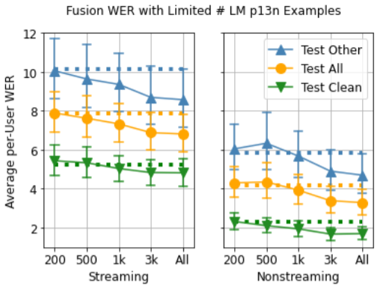
Experiment
Trained 86M parameter Conformer Hybrid Autoregressive
Transducer (HAT) models & two Conformer HAT models.
Fusion with the general language model for better performance.
They targeted the cases where personalized language model is able to correctly predict examples that the baseline or general language model predicted incorrectly, and found that proper nouns seen more frequently in the personalized language model training data can be a source of the win, but there are also some losses due to over-predicting words.

Slide 10
Conclusion
They demonstrate a use case (UserLibri) where they are able
to improve average per-user word error rate in both streaming and non-
streaming models, bringing down streaming word error rate on the hardest group of users by 1.2 by performing shallow fusion with
personalized language models of only 3M parameters, or an improvement
of 2.5 with 25M LMs.

